Slide 1
What Has Money Got to Do with It?
Financial Characteristics of Vital, Healthy and Growing Churches
Warren Bird, Ph.D.

Slide 2
About Warren Bird
Ph.D. Fordham University, M.Div. Alliance Theological Seminary, M.A., B.A. Wheaton College.
Research Director, Leadership Network since 2006. Specialty on megachurch, multisite, large-church compensation, high-visibility succession.
Co-authored 29 ministry books, author 200 magazine articles, numerous research reports.
Follow on Twitter @warrenbird
Leadnet.org/advance subscribe to Advance, free email newsletter of trends and resources.
Staff pastor 1986-2006,
Alliance Theological Seminary since 1995.

Slide 5
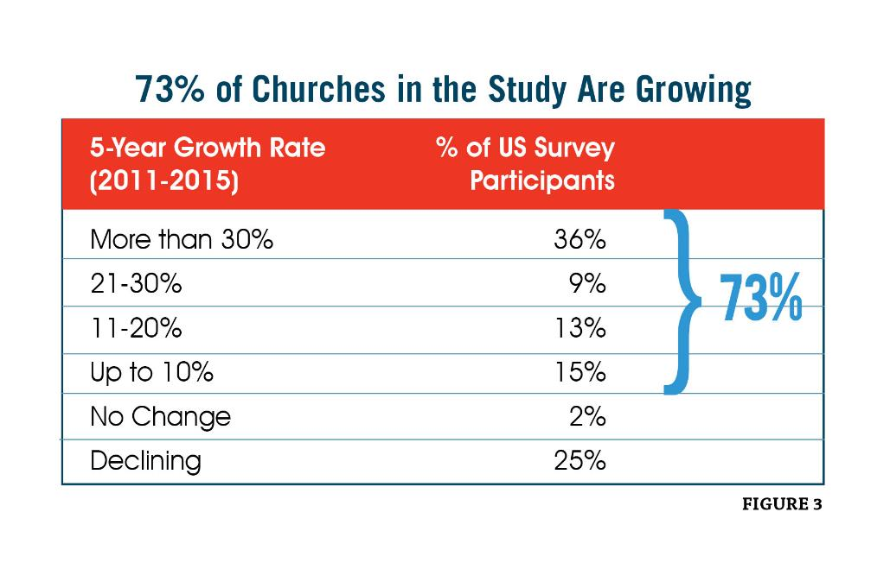

Slide 7
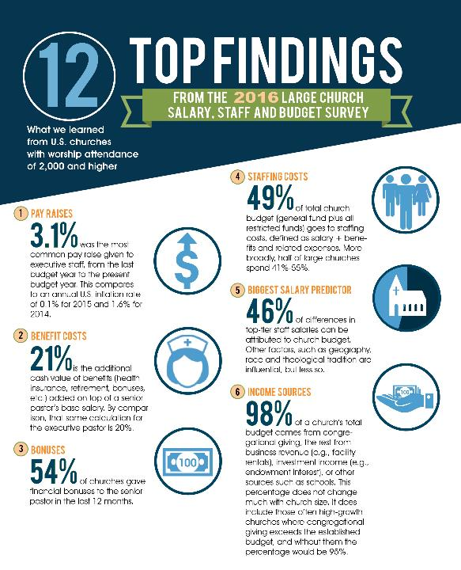

Slide 8
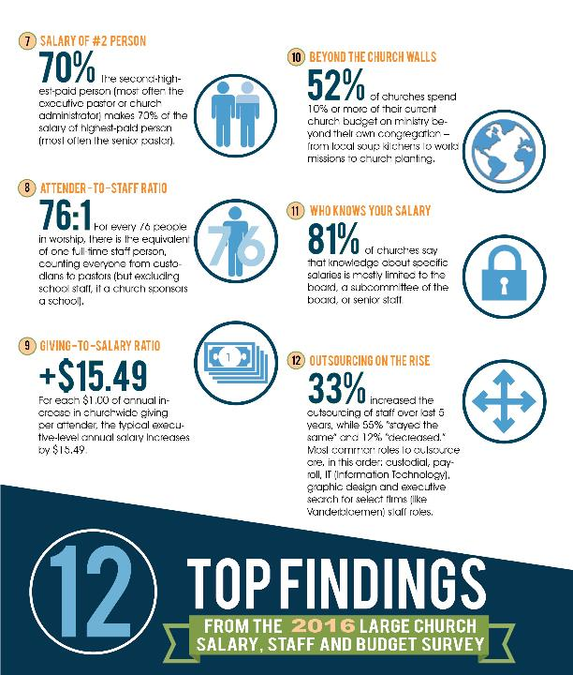

Slide 9
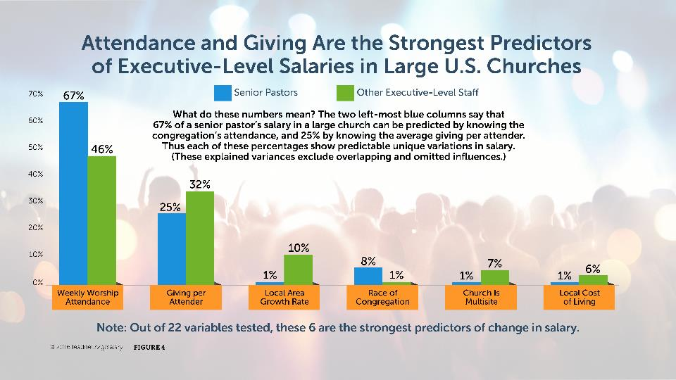

Slide 10
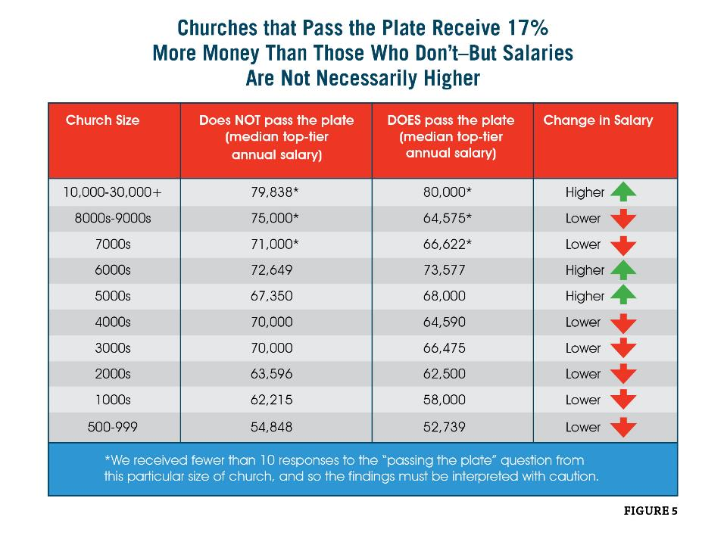

Slide 11
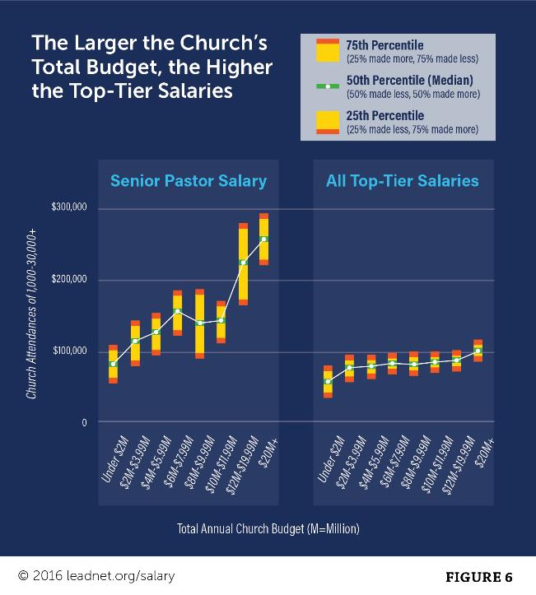

Slide 12
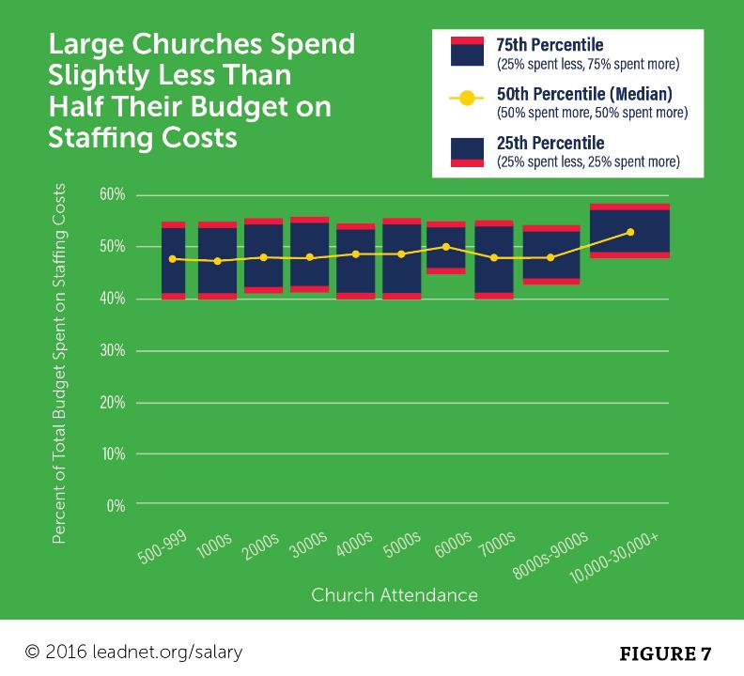

Slide 14
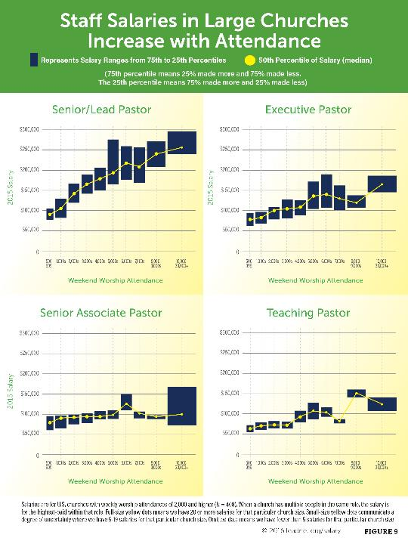

Slide 15
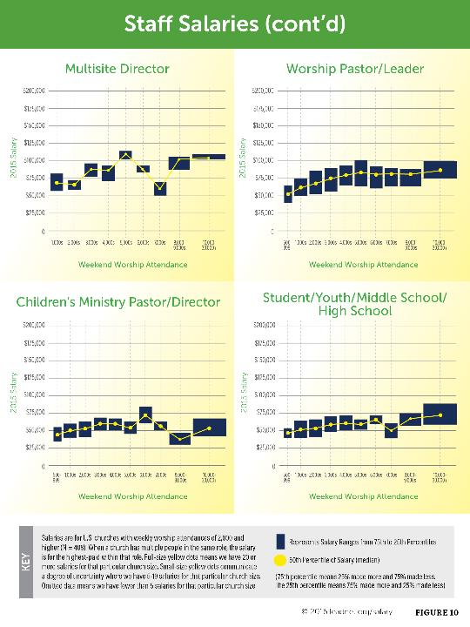

Slide 16
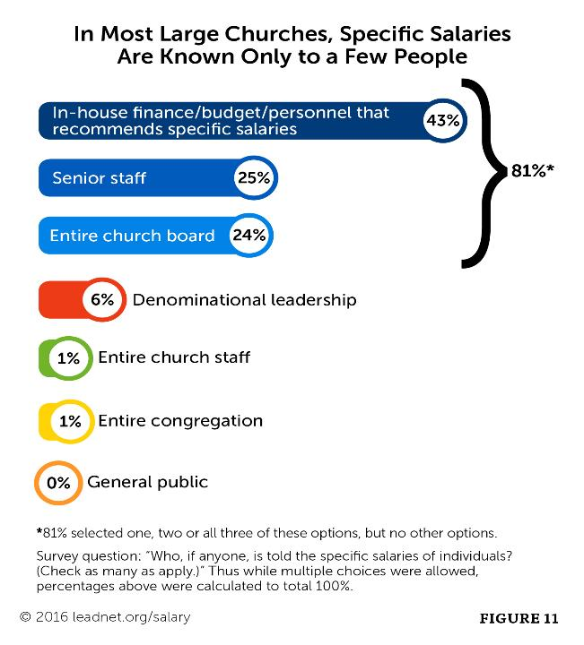

Slide 21
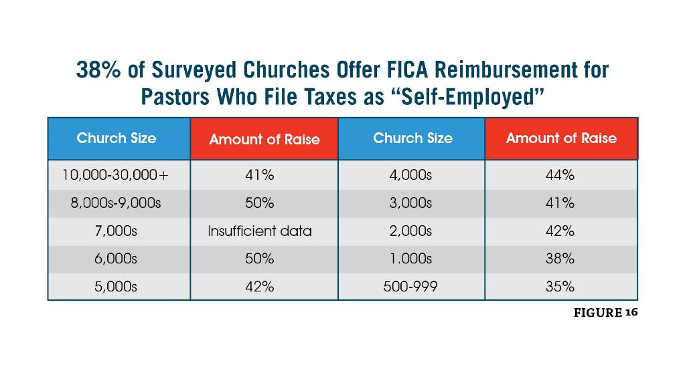

Slide 22
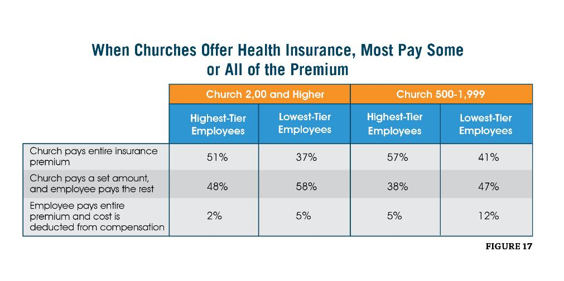

Slide 25
Following Leadership Network
@warrenbird, @leadnet
www.leadnet.org/advance

